Slide 1
Introduction to HTML5

Slide 2
Introduction
HTML5 (HyperText Markup Language 5)
markup language that specifies the structure and content of documents that are displayed in web browsers
Here we will study:
Basics HTML
tables, which are particularly useful for structuring information from databases (i.e., software that stores structured sets of data)
forms for collecting information from web-page visitors
internal linking for easier page navigation
meta elements for specifying information about a document

Slide 3
Editing HTML5
We’ll create HTML5 documents by typing HTML5 markup text in a text editor (such as Notepad, TextEdit, vi, emacs) and saving it with the .html or .htm filename extension.
Computers called web servers store HTML5 documents.
Clients (such as web browsers running on your local computer or smartphone) request specific resources such as HTML5 documents from web servers.

Slide 4
First HTML5 Example
Next figure shows an HTML5 document named main.html.
This first example displays the message Welcome to HTML5! in the browser.

Slide 5
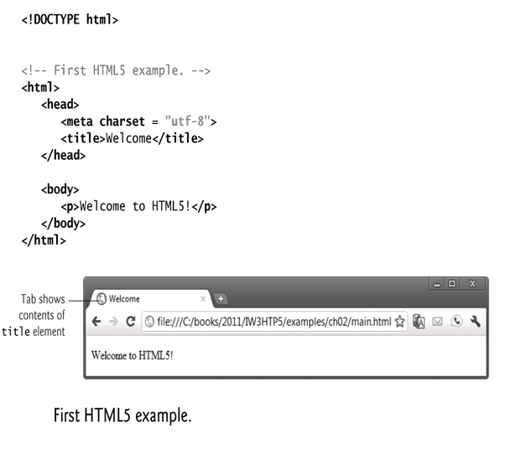
First HTML5 Example(Cont’s)

Slide 6
First HTML5 Example(Cont’s)
Document Type Declaration
The document type declaration (DOCTYPE) is required in HTML5 documents so that browsers render the page in standards mode.
Some browsers operate in quirks mode to maintain backward compatibility with web pages that are not up-to-date with the latest standards.

Slide 7
First HTML5 Example(Cont’s)
Comments
Insert comments in your HTML5 markup to improve readability and describe the content of a document.
The browser ignores comments when your document is rendered.
Comments start with <!-- and end with -->.

Slide 8
First HTML5 Example(Cont’s)
html, head and body Elements
HTML5 markup contains text (and images, graphics, animations, audios and videos) that represents the content of a document and elements that specify a document’s structure and meaning.
The html element encloses the head section (represented by the head element) and the body section (represented by the body element).
The head section contains information about the HTML5 document, such as the character set (UTF-8, the most popular character-encoding scheme for the web) that the page use—which helps the browser determine how to render the content—and the title.
The head section also can contain special document-formatting instructions called CSS3 style sheets and client-side programs called scripts for creating dynamic web pages.
The body section contains the page’s content, which the browser displays when the user visits the web page.

Slide 9
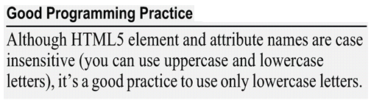
First HTML5 Example (cont.)
Start Tags and End Tags
HTML5 documents delimit most elements with a start tag and end tag.
A start tag consists of the element name in angle brackets
For example, <html>
An end tag consists of the element name preceded by a forward slash (/) in angle brackets
For example, </html>
There are several so-called “void elements” that do not have end tags.
Many start tags have attributes that provide additional information about an element, which browsers use to determine how to process the element.
Each attribute has a name and a value separated by an equals sign (=).

Slide 10
First HTML5 Example (Cont.)
Title Element
The title element is called a nested element, because it’s enclosed in the head element’s start and end tags.
The head element is also a nested element, because it’s enclosed in the html element’s start and end tags.
The title element describes the web page. how ?
Titles usually appear in the title bar at the top of the browser window, in the browser tab on which the page is displayed,
title element describes as the text identifying a page when users add the page to their list of Favorites or Bookmarks, enabling them to return to their favorite sites.
Search engines use the title for indexing purposes and when displaying results

Slide 11
First HTML5 Example (Cont.)
Paragraph Element (<p>...</p>)
All text placed between the <p> and </p> tags forms one paragraph.

Slide 12
Headings
HTML5 provides six heading elements (h1 through h6) for specifying the relative importance of information
Heading element h1 is considered the most significant heading and is rendered in the largest font.
Each successive heading element (i.e., h2, h3, etc.) is rendered in a progressively smaller font.
Text size used to display each heading element can vary between browser, thus we can use CSS to control size and other text properties
Placing a heading at the top of each page helps viewers understanding the purpose of the page
Headers also help create an outline for a document and are indexed by search engine

Slide 13
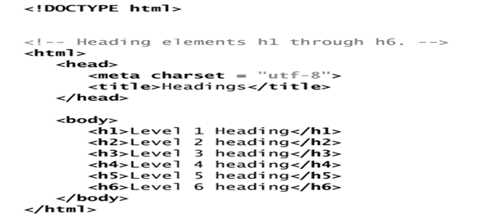
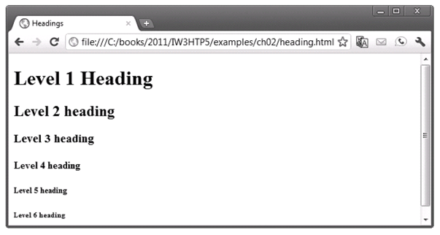
Example

Slide 14
Linking
A hyperlink references or links to other resources, such as HTML5 documents and images.
Web browsers typically underline text hyperlinks and color them blue by default.

Slide 15
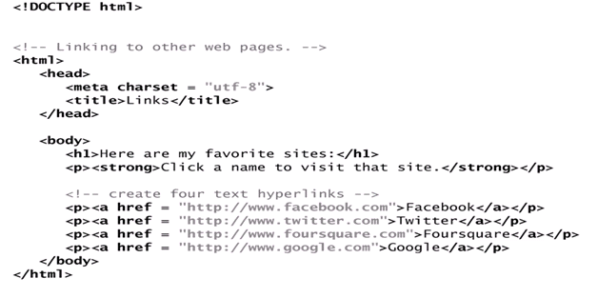
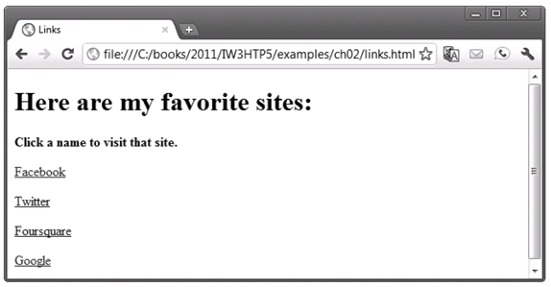
Example

Slide 16

Linking (Cont.)
The strong element indicates that the content has high importance. Browsers typically render such text in a bold font.
Links are created using the a (anchor) element.
Attribute href (hypertext reference) specifies a resource’s location, such as
a web page or location within a web page
a file
an e-mail address
When a URL does not indicate a specific document on the website, the web server returns a default web page. This page is often called index.html, but most web servers can be configured to use any file as the default web page for the site.
If the web server cannot locate a requested document, it returns an error indication to the web browser (known as a 404 error), and the browser displays a web page containing an error message.

Slide 17
Linking (Cont.)
Hyperlinking to an E-Mail Address
Anchors can link to an e-mail address using a mailto: URL
When a user clicks this type of anchored link, most browsers launch the default e-mail program (e.g., Mozilla Thunderbird, Microsoft Outlook or Apple Mail) to enable the user to write an e-mail message to the linked address.

Slide 18
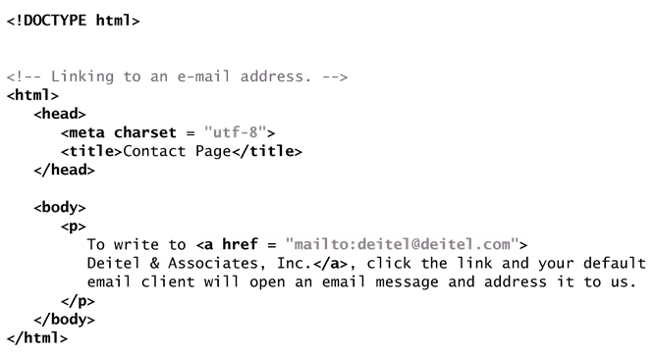
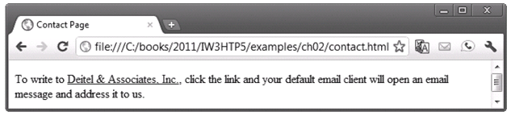
Example

Slide 19
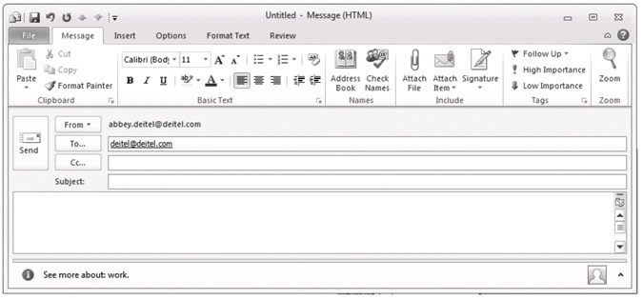
Example(Cont’s)

Slide 20
Images
The most popular image formats used by web developers today are PNG (Portable Network Graphics) and JPEG (Joint Photographic Experts Group).
Users can create images using specialized software, such as Adobe Photoshop Express (www.photoshop.com), G.I.M.P. (www.gimp.org), Inkscape (www.inkscape.org) and many more.
Images may also be acquired from various websites, many of which offer royalty-free images.

Slide 21
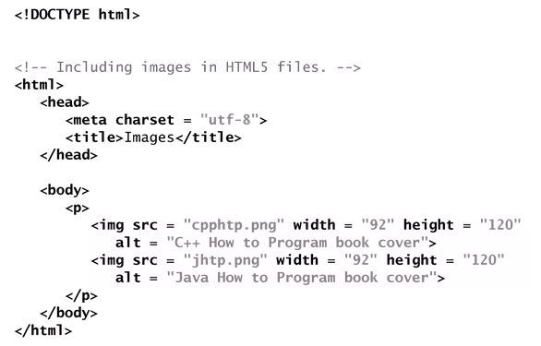
Example

Slide 22
Images (cont.)
The img element’s src attribute specifies an image’s location
Every img element should have an alt attribute, which contains text that is displayed if the client cannot render the image
Width and height are optional attributes
If omitted, the browser uses the image’s actual width and height
Images are measured in pixels

Slide 23
Images (Cont.)
Void Elements
Some HTML5 elements (called void elements) contain only attributes and do not mark up text (i.e., text is not placed between a start and an end tag).
You can terminate void elements (such as the img element) by using the forward slash character (/) inside the closing right angle bracket (>) of the start tag.
For example, lines 15–16 of Fig. 2.6 could be written as follows:
<img src = "jhtp.png" width = "92" height = "120"
alt = "Java How to Program book cover" />

Slide 24
Images (Cont.)
Using Images as Hyperlinks
By using images as hyperlinks, you can create graphical web pages that link to other resources.
In Next figure, we create five different image hyperlinks.
Clicking an image in this example takes the user to a corresponding web .

Slide 25
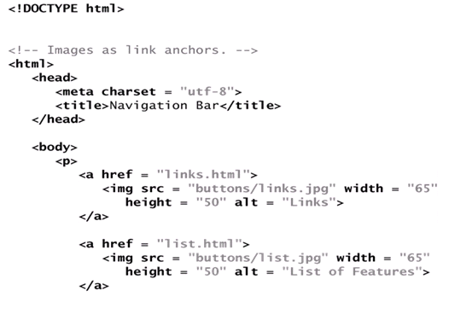
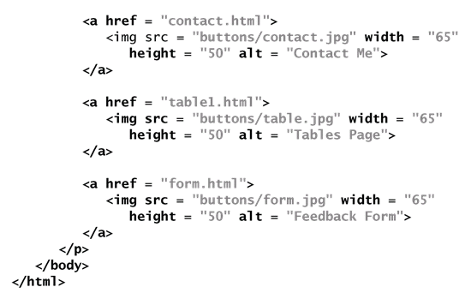
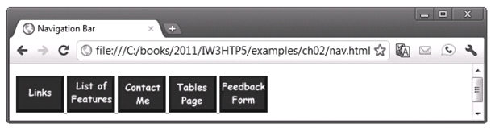
Example

Slide 26
Special Characters and Horizontal Rules
HTML5 provides character entity references (in the form &code;) for representing special characters that cannot be rendered otherwise
The code can be:
Word abbreviations
Numbers
Decimal
Hexadecimal

Slide 27
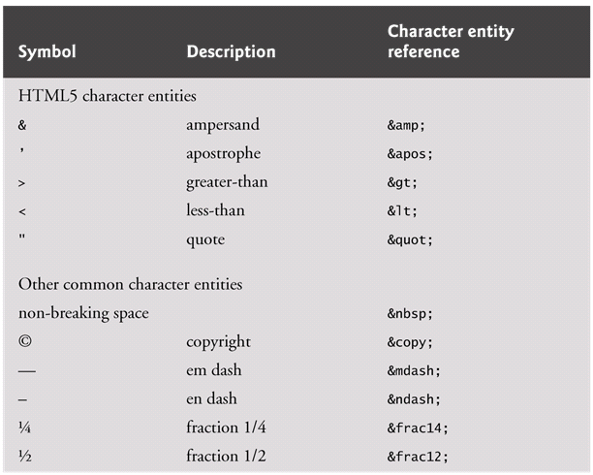
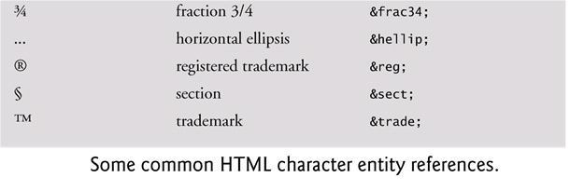

Slide 28
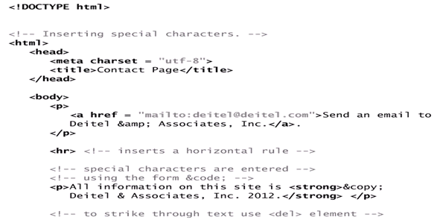
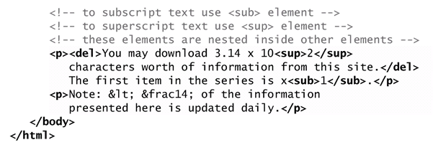
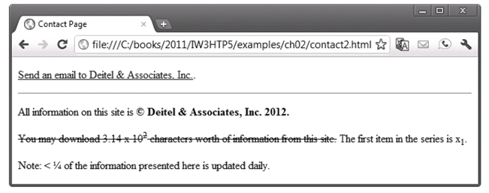
Example

Slide 29
Special Characters and Horizontal Rules (Cont.)
A horizontal rule, indicated by the <hr> tag renders a horizontal line with extra space above and below it in most browsers.
The horizontal rule element should be considered a legacy element and you should avoid using it.
CSS can be used to add horizontal rules and other formatting to documents.
Special characters can also be represented as numeric character references—decimal or hexadecimal (hex) values representing special characters.
For example, the & character is represented in decimal and hexadecimal notation as &#38; and &#x26;, respectively.

Slide 30
Lists
Unordered list element ul
creates a list in which each item in the list begins with a bullet symbol (typically a disc)
Each entry is an li (list item) element. Most web browsers render these elements with a line break and a bullet symbol at the beginning of the line.

Slide 31
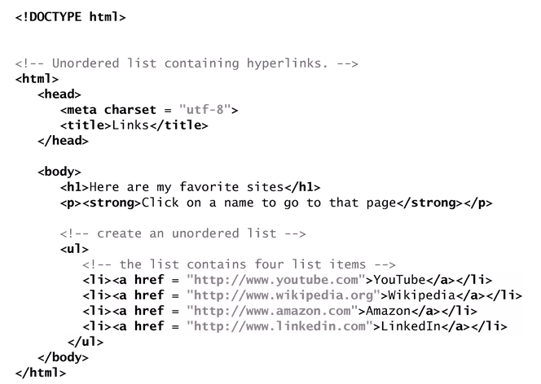
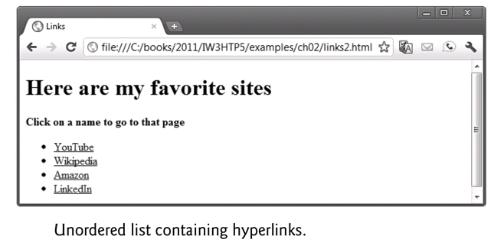
Example

Slide 32
Lists (Cont.)
Nested Lists
Lists may be nested to represent hierarchical relationships, as in a multi-level outline.
Next demonstrates nested lists and ordered lists.
The ordered-list element ol creates a list in which each item begins with a number.

Slide 33
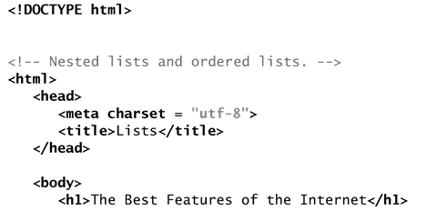
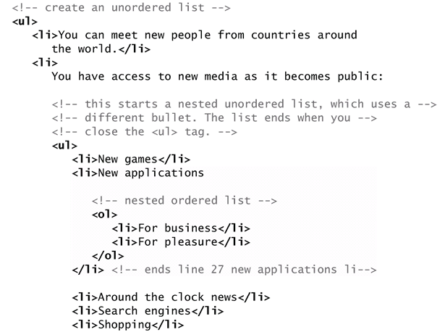
Example

Slide 34
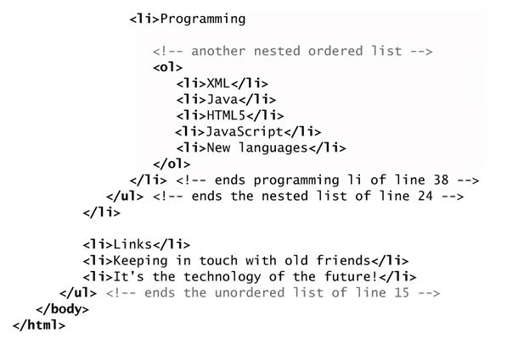
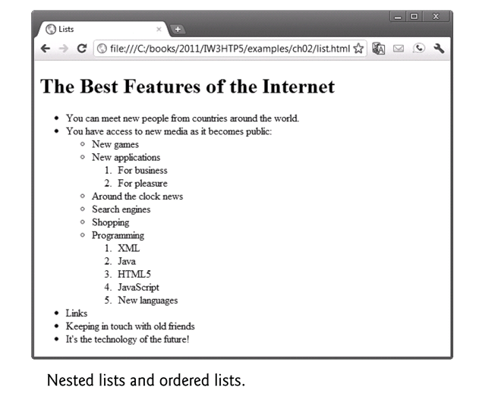
Example(Cont’s)

Slide 35
Tables
Tables are frequently used to organize data into rows and columns.
The table element defines an HTML5 table
The caption element specifies a table’s title.
A table can be split into three distinct sections:
Head (thead element)
Table titles
Column headers
Body (tbody element)
Primary table data
Table Foot (tfoot element)
Calculation results
Footnotes
Above body section in the code, but displays at the bottom in the page

Slide 36
Tables (Cont.)
tr Element
Defines individual table rows
Element th
Defines a header cell
Td Element
Contains table data elements

Slide 37
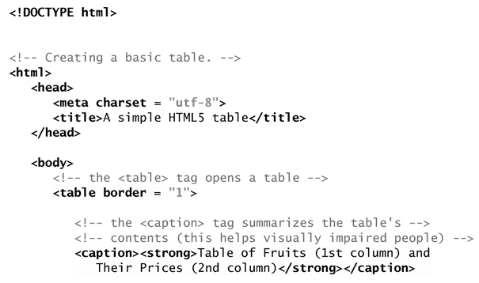
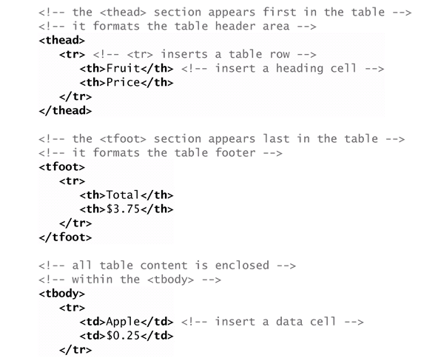
Example

Slide 38
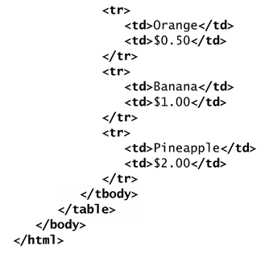
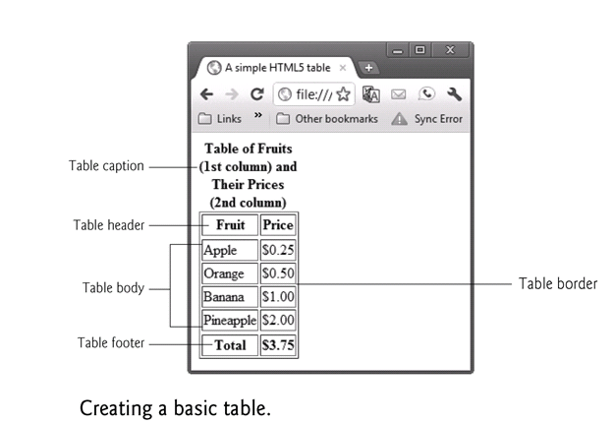
Example(Cont’s)

Slide 39
Tables (Cont.)
Using rowspan and colspan with Tables
Next Figure introduces two new attributes that allow you to build more complex tables.
You can merge data cells with the rowspan and colspan attributes
The values of these attributes specify the number of rows or columns occupied by the cell.
Can be placed inside any data cell or table header cell.
The br element is render as a line break in most browsers—any markup or text following a br element is rendered on the next line.
Like the img element, br is an example of a void element.
Like the hr element, br is considered a legacy formatting element that you should avoid using—in general, formatting should be specified using CSS.

Slide 40
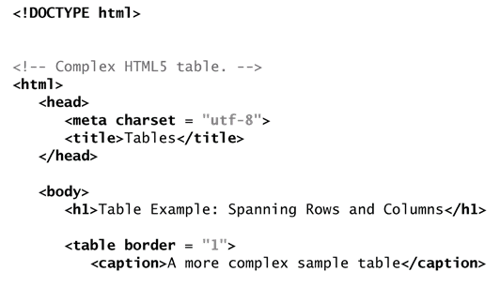
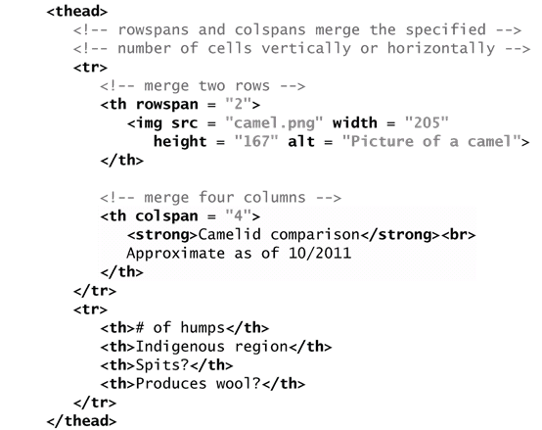
Example

Slide 41
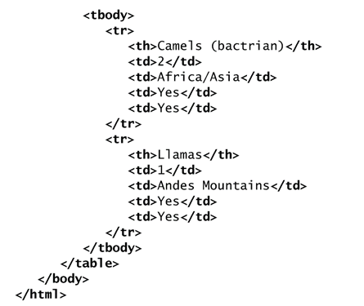
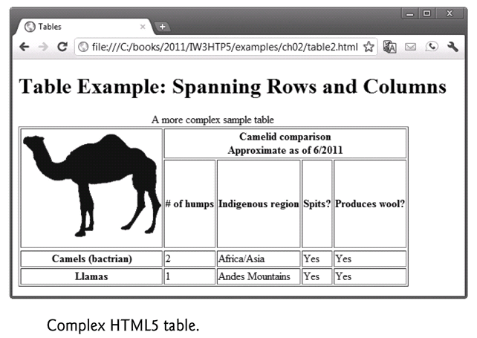
Example(Cont’s)

